Slide 1
Electronics & Electricity
Unit 6 – TinkerCAD Circuits
Section 1 – TinkerCAD Circuits

Slide 2
TinkerCAD Circuits
TinkerCAD Circuits

Slide 3
The big idea
Familiarity with TinkerCAD
Designed circuits in a virtual environment
Ohm’s Law practice

Slide 4
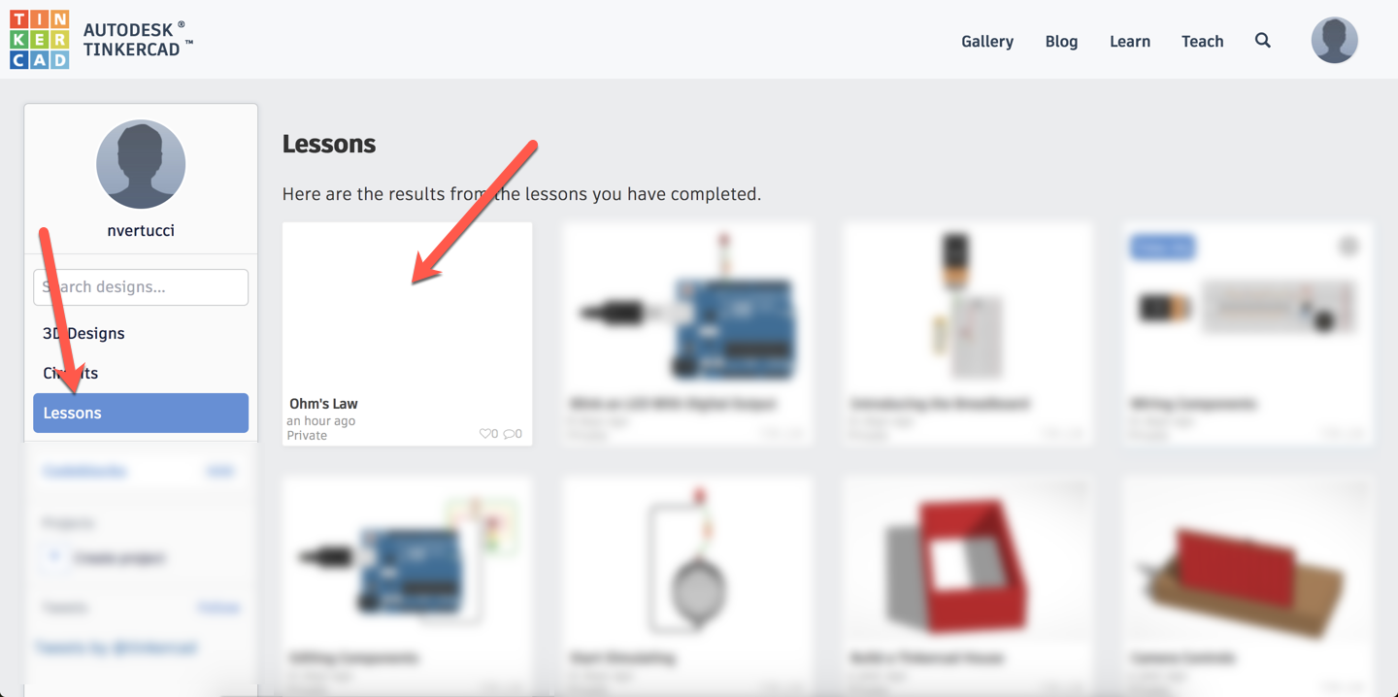
TinkerCAD Circuits

Slide 5
TinkerCAD Circuits – Ohm’s Law
Work in groups of 2
Log into one students TinkerCAD account
Find the lessons area within your profile
Select the Ohm’s Law lesson
Complete the lesson and share a snapshot of the assignment to google classroom

Slide 6
TinkerCAD Circuits – Voltage Drop
Work in groups of 2
Log into one students TinkerCAD account
Create a simple WORKING series circuit with this 2 set of criteria:
18V source
3 LEDs
[1 RED, 1 GREEN, 1 BLUE] in this circuit order
When completed, select share to download a snapshot of your circuit and submit to the Classroom assignment

